Slide 1
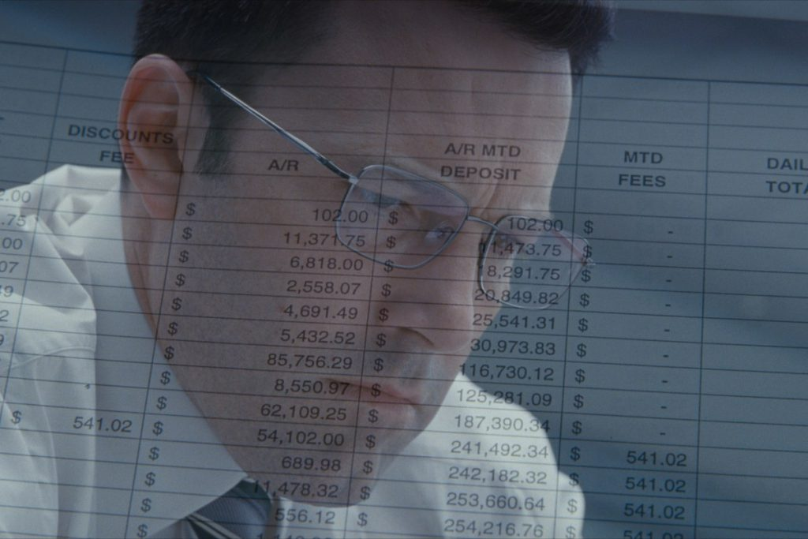
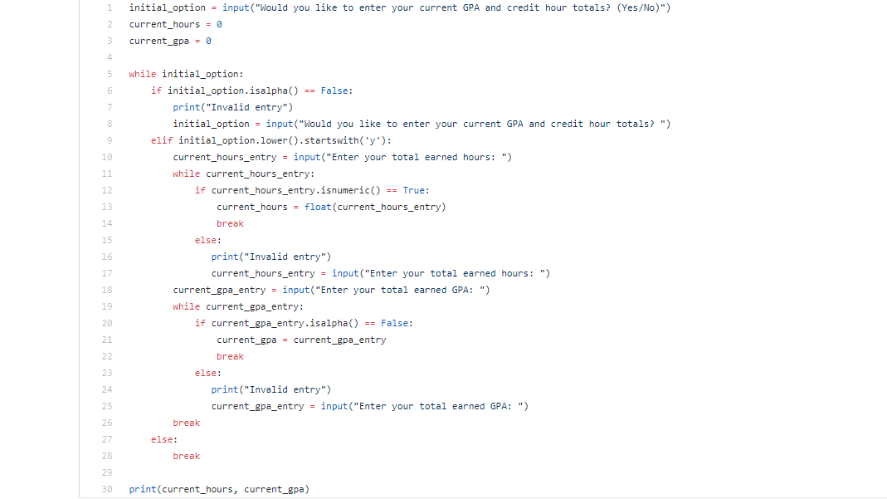
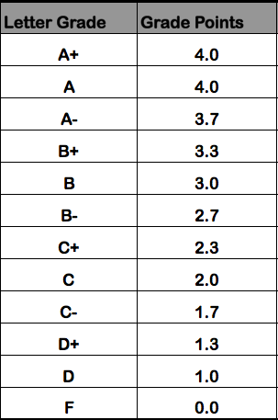
GPA CALCULATOR By: Amanda Jones & Chase MacDonald
We calculate your GPA so you can focus on making it higher!

Slide 2
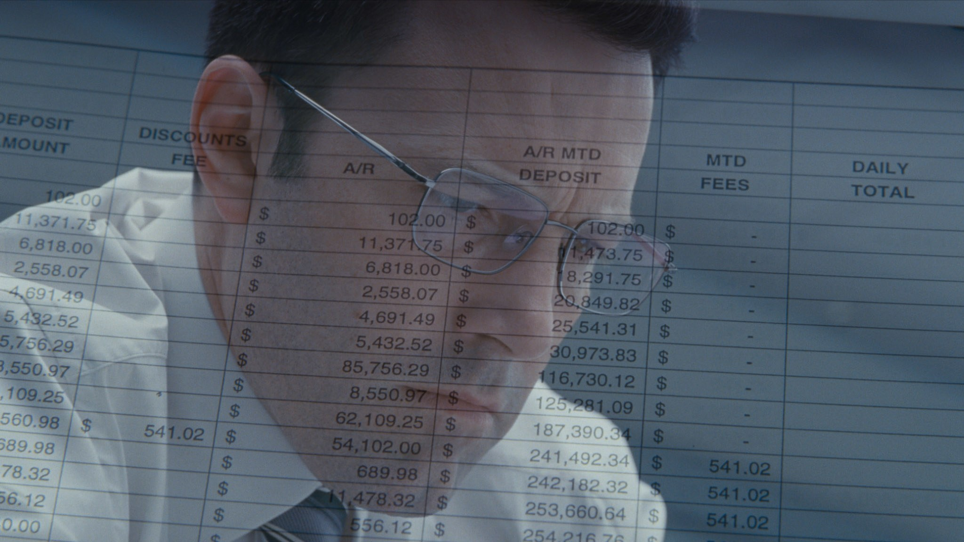
GPA Calculator Presentation

Slide 3
The End

